Slide 1


DEPARTMENT BES-1
  Course: Data Structures using Python
Course code: 24sc1204
    Topic: INSERTION SORT
Session-01

Slide 2



AIM OF THE SESSION
To familiarize students with the basic concept of Insertion Sort and Shell Sort
INSTRUCTIONAL OBJECTIVES
This Session is designed to:
Demonstrate Insertion Sort
Describe how the sorting technique work
List out the steps of the sorting algorithm
LEARNING OUTCOMES
At the end of this session, you should be able to:
Define Insertion Sort
Describe algorithm and complexity of Insertion Sort
Summarize Insertion Sort

Slide 3
SESSION INTRODUCTION
Insertion sort: orders a list of values by repetitively inserting a particular value into a sorted subset of the list
More specifically:
  consider the first item to be a sorted sublist of length 1
  insert the second item into the sorted sublist, shifting the first item if needed
  insert the third item into the sorted sublist, shifting the other items as needed
  repeat until all values have been inserted into their proper positions

Slide 4
Insertion Sort
SESSION DESCRIPTION (Cont..)
while some elements unsorted:
  Using linear search, find the location in the sorted portion where the 1st element of the unsorted portion should be inserted
  Move all the elements after the insertion location up one position to make space for the new element
45
38
60
45
66
60
45
66
79
47
13
74
36
21
94
22
57
16
29
81
the fourth iteration of this loop is shown here

Slide 5
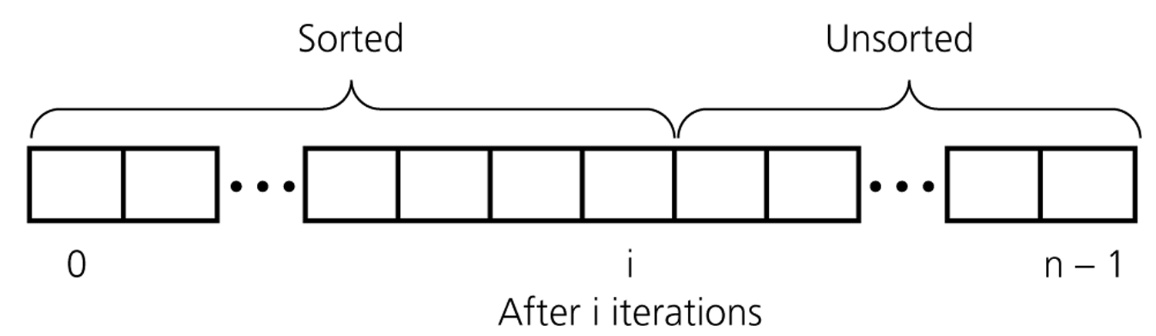
SESSION DESCRIPTION (Cont..)
An insertion sort partitions the array into two regions

Slide 6
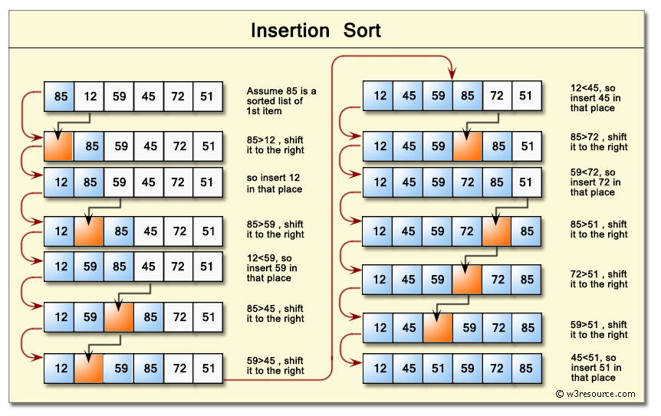
SESSION DESCRIPTION (Cont..)

Slide 7
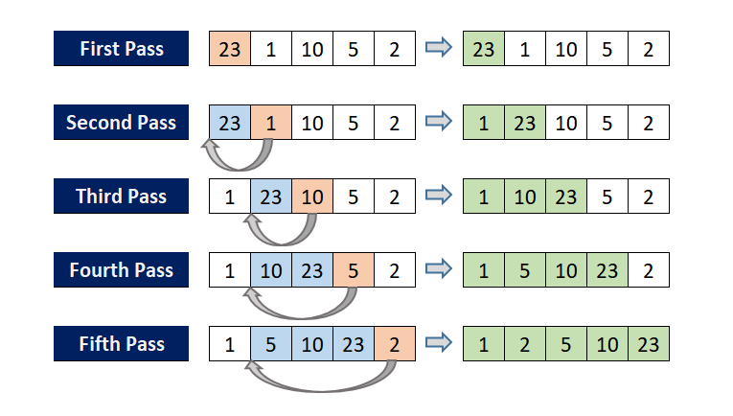
Insertion Sort
SESSION DESCRIPTION (Cont..)

Slide 8
SESSION DESCRIPTION (Cont..)
Steps of the algorithm
Step 1 − If it is the first element, it is already sorted. return 1;
Step 2 − Pick next element
Step 3 − Compare with all elements in the sorted sub-list
Step 4 − Shift all the elements in the sorted sub-list that is greater than the value to be sorted
Step 5 − Insert the value
Step 6 − Repeat until list is sorted

Slide 9
Insertion Sort Analysis
SESSION DESCRIPTION (Cont..)
def insertion_sort(arr):
for i in range(1, len(arr)):
key = arr[i]
j = i - 1
while j >= 0 and arr[j] > key:
arr[j + 1] = arr[j]
j -= 1
arr[j + 1] = key
arr = [12, 11, 13, 5, 6]
insertion_sort(arr)
print("Sorted array is:", arr)

Slide 10
Insertion Sort: Number of Comparisons
SESSION DESCRIPTION (Cont..)
# of Sorted Elements | Best case | Worst case
0 | 0 | 0
1 | 1 | 1
2 | 1 | 2
… | … | …
n-1 | 1 | n-1
 | n-1 | n(n-1)/2
Remark: we only count comparisons of elements in the array.

Slide 11
Insertion Sort: Cost Function
SESSION DESCRIPTION (Cont..)
1 operation to initialize the outer loop
The outer loop is evaluated n-1 times
  5 instructions (including outer loop comparison and increment)
  Total cost of the outer loop: 5(n-1)
How many times the inner loop is evaluated is affected by the state of the array to be sorted
Best case: the array is already completely sorted so no “shifting” of array elements is required.
  We only test the condition of the inner loop once (2 operations = 1 comparison + 1 element comparison), and the body is never executed
  Requires 2(n-1) operations.

Slide 12
Insertion Sort: Cost Function
SESSION DESCRIPTION (Cont..)
Worst case: the array is sorted in reverse order (so each item has to be moved to the front of the array)
  In the i-th iteration of the outer loop, the inner loop will perform 4i+1 operations
  Therefore, the total cost of the inner loop will be 2n(n-1)+n-1
Time cost:
  Best case: 7(n-1)
  Worst case: 5(n-1)+2n(n-1)+n-1
What about the number of moves?
  Best case: 2(n-1) moves
  Worst case: 2(n-1)+n(n-1)/2

Slide 13
Insertion Sort: Average Case
SESSION DESCRIPTION (Cont..)
Is it closer to the best case (n comparisons)?
The worst case (n * (n-1) / 2) comparisons?
It turns out that when random data is sorted, insertion sort is usually closer to the worst case
  Around n * (n-1) / 4 comparisons
  Calculating the average number of comparisons more exactly would require us to state assumptions about what the “average” input data set looked like
  This would, for example, necessitate discussion of how items were distributed over the array
Exact calculation of the number of operations required to perform even simple algorithms can be challenging
(for instance, assume that each initial order of elements has the same probability to occur)

Slide 14
SESSION DESCRIPTION (Cont..)
Best case: array is in sorted ascending order - O(n)
Average case: each element is about halfway in order - O(n²)
Worst case: reverse-ordered elements in array - O(n²)

Slide 15
EXAMPLES
The most suitable example of insertion sort is to sort the cards in hand.
The way a player sorts his cards in hand by taking the first one the comparing it with the next is the fundamental form of insertion sort

Slide 16
SUMMARY
This algorithm is one of the simplest algorithm with simple implementation
Basically, Insertion sort is efficient for small data values
Insertion sort is adaptive in nature, i.e. it is appropriate for data sets which are already partially sorted.

Slide 17
SELF-ASSESSMENT QUESTIONS
How many passes of insertion sort do we need to give for an array of size n to sort?
n
n+1
n-1
(n+1)/2
What is the complexity of Insertion sort in worst case scenario?
O(n)
O(nlog n)
O(n²)
O(2n log n)

Slide 18
TERMINAL QUESTIONS
1. Describe what is insertion sort.
2. List out the steps involved in insertion sort.
3. Analyze the complexity of insertion sort.
4. Summarize the working principle of insertion sort.

Slide 19
REFERENCES FOR FURTHER LEARNING OF THE SESSION
Reference Books:
Sites and Web links:
  https://docs.python.org/3/tutorial/datastructures.html
  https://www.w3schools.com/dsa/dsa_intro.php
  https://www.geeksforgeeks.org/python-data-structures/
  https://onlinecourses.nptel.ac.in/noc25_cs59/preview
  https://www.coursera.org/learn/python-data
  https://www.codecademy.com/learn/learn-data-structures-and-algorithms-with-python
Data Structures and Algorithm Analysis in PYTHON, 2010, Mark Allen Weiss, Second Edition, Pearson Education.
Data Structures and Algorithms, A.V.Aho, J.E.Hopcroft, and J.D.Ullman, Pearson Education, First Edition Reprint2003.
Advanced Guide to Python 3 Programming, John Hunt, 4th Edition, Springer Nature Switzerland AG 2019.
Python Basics: A Practice Introduction to Python 3, David Amos, Dan Bader, Joanna Jablonski, Fletcher Heisler, 4th edition, Real Python.

Slide 20
THANK YOU
Team – Data Structures using Python

